Slide 2
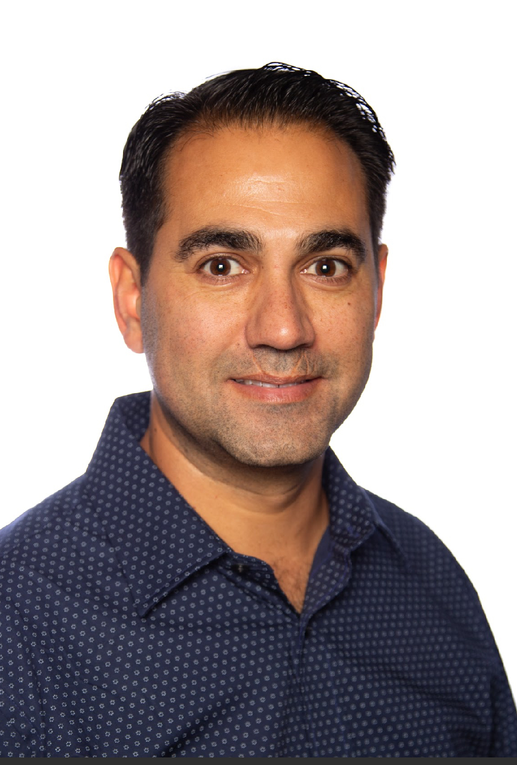
Justin Sider Chief Information Officer Belay Technologies
Invoke-VCF –Version 9 InstallType Full –Confirm:$false

Slide 3

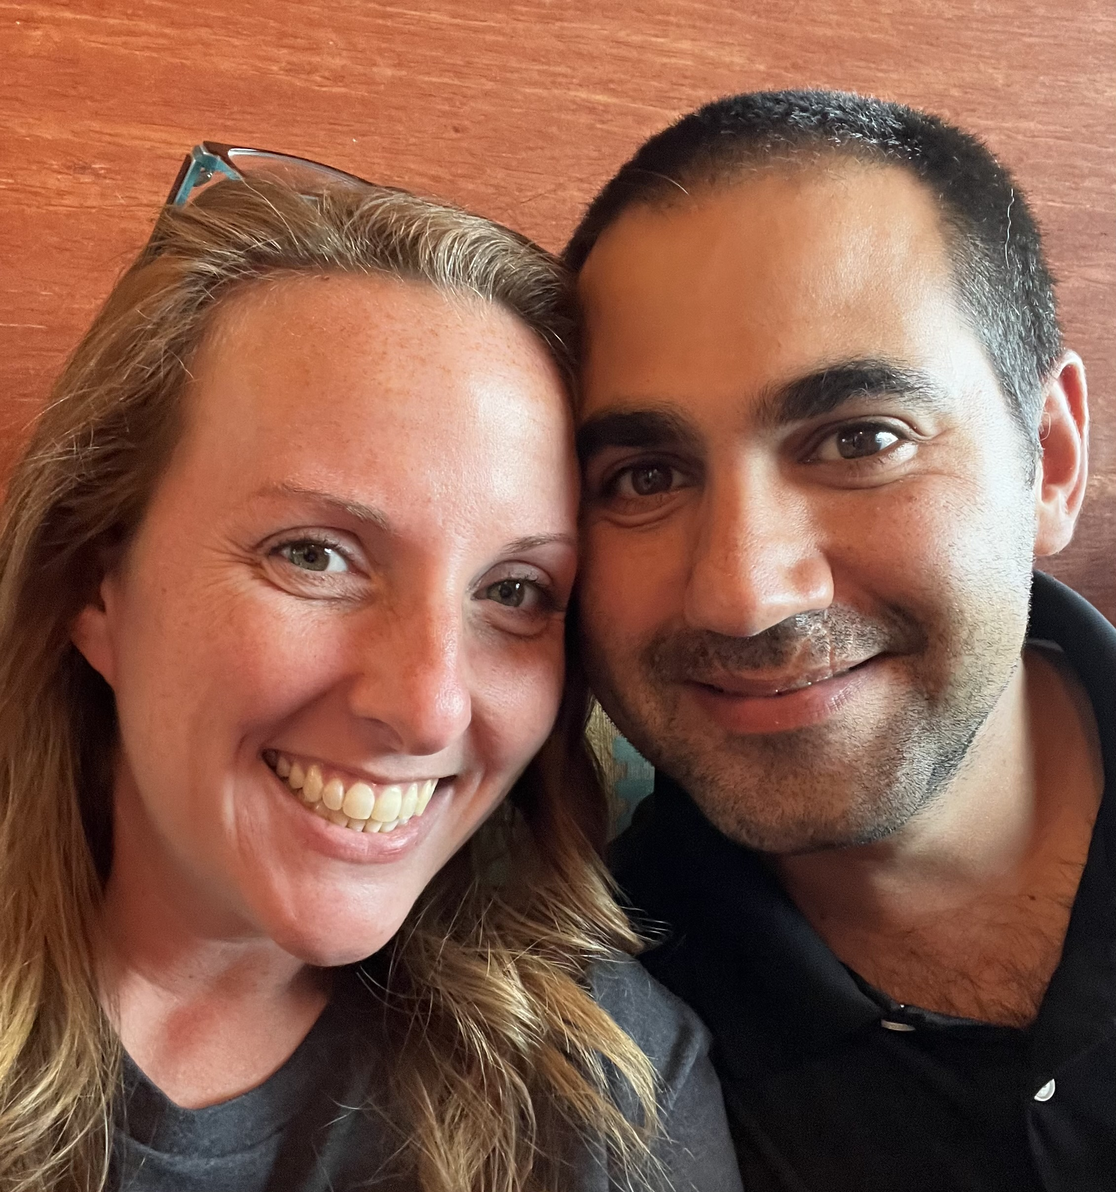

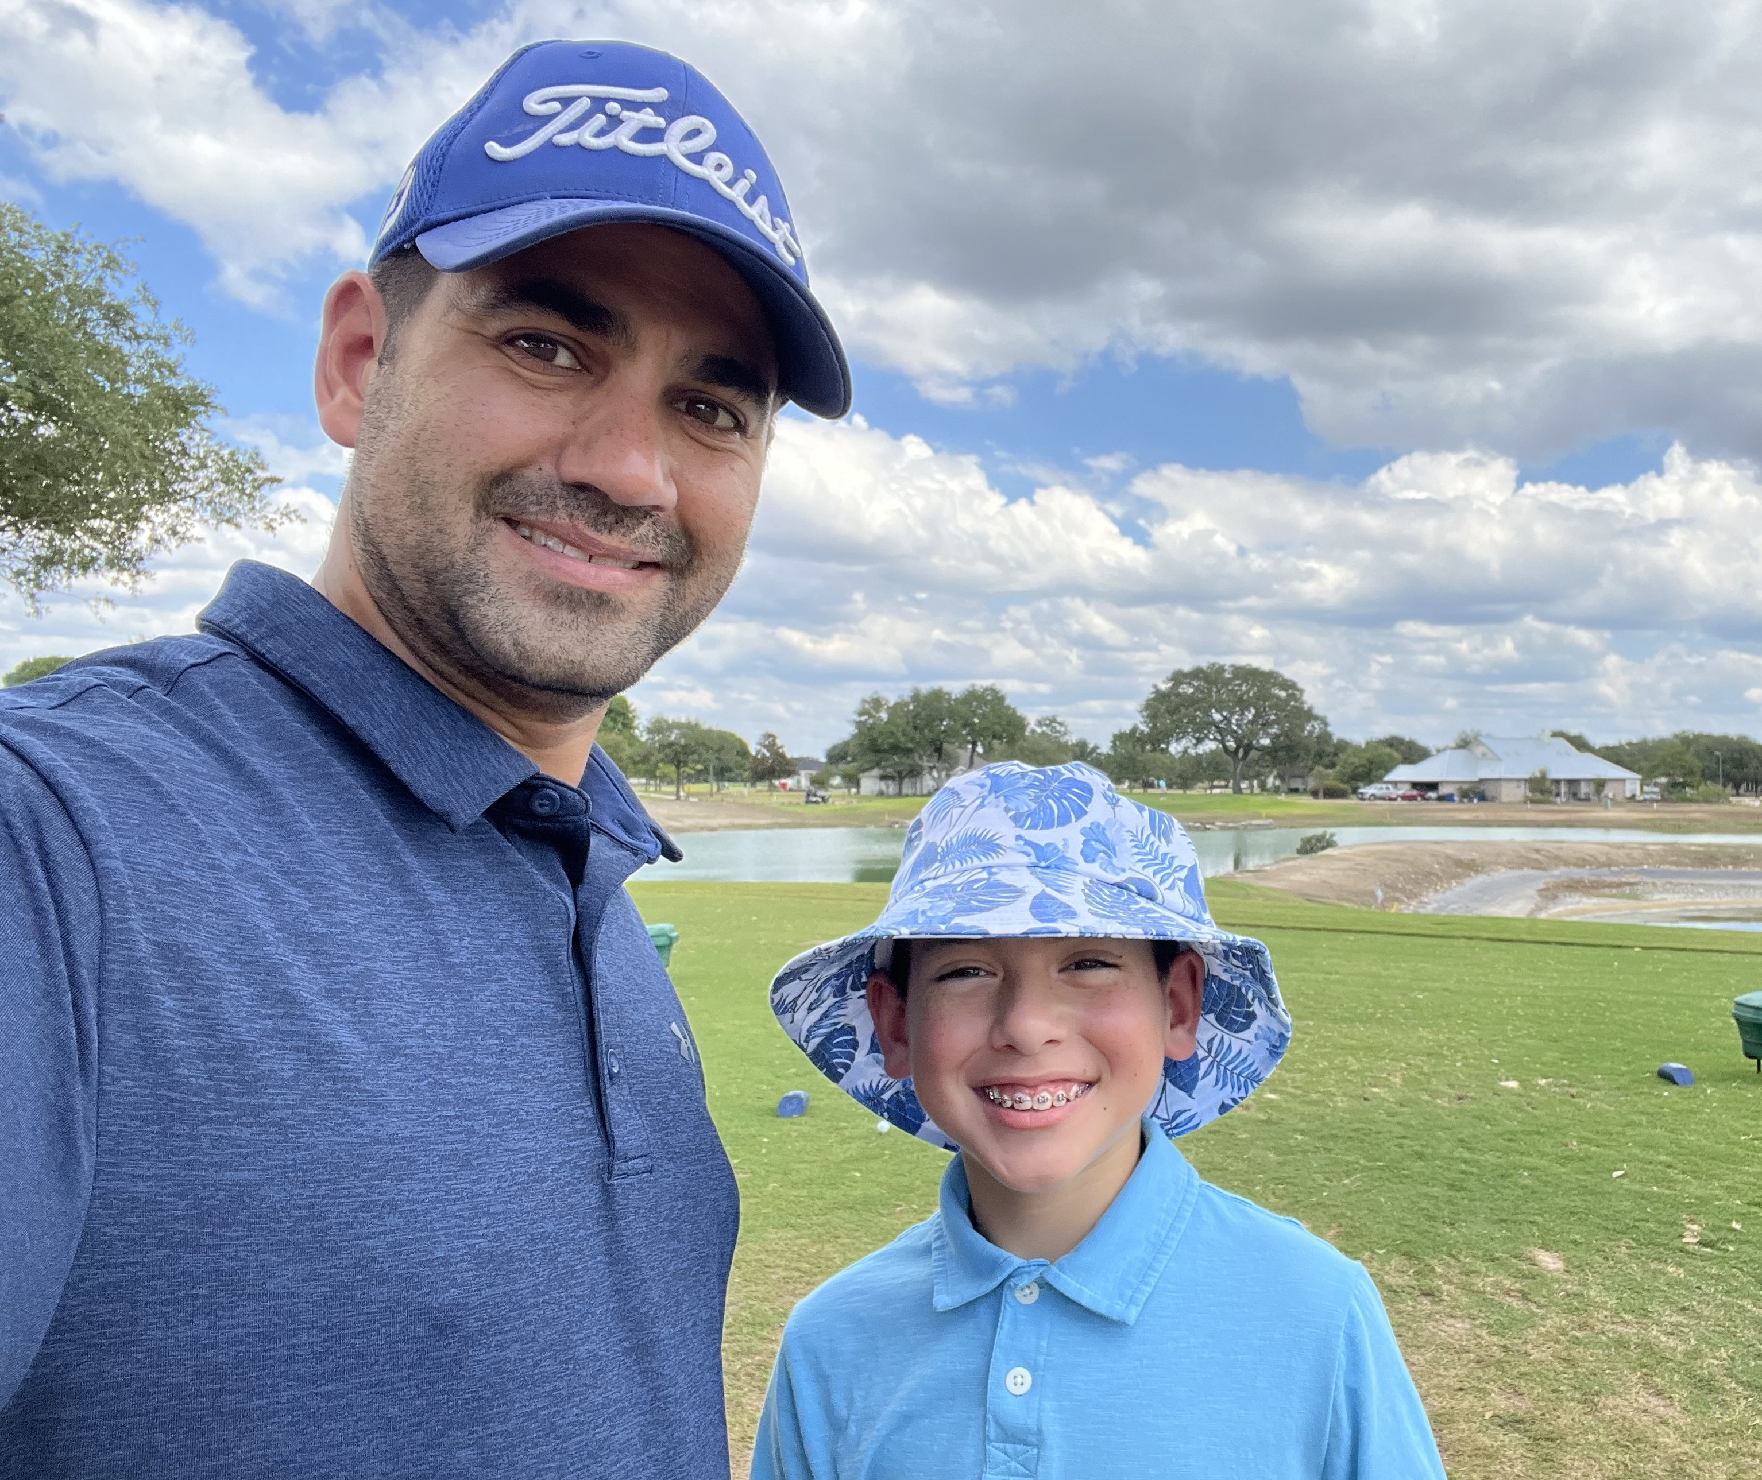
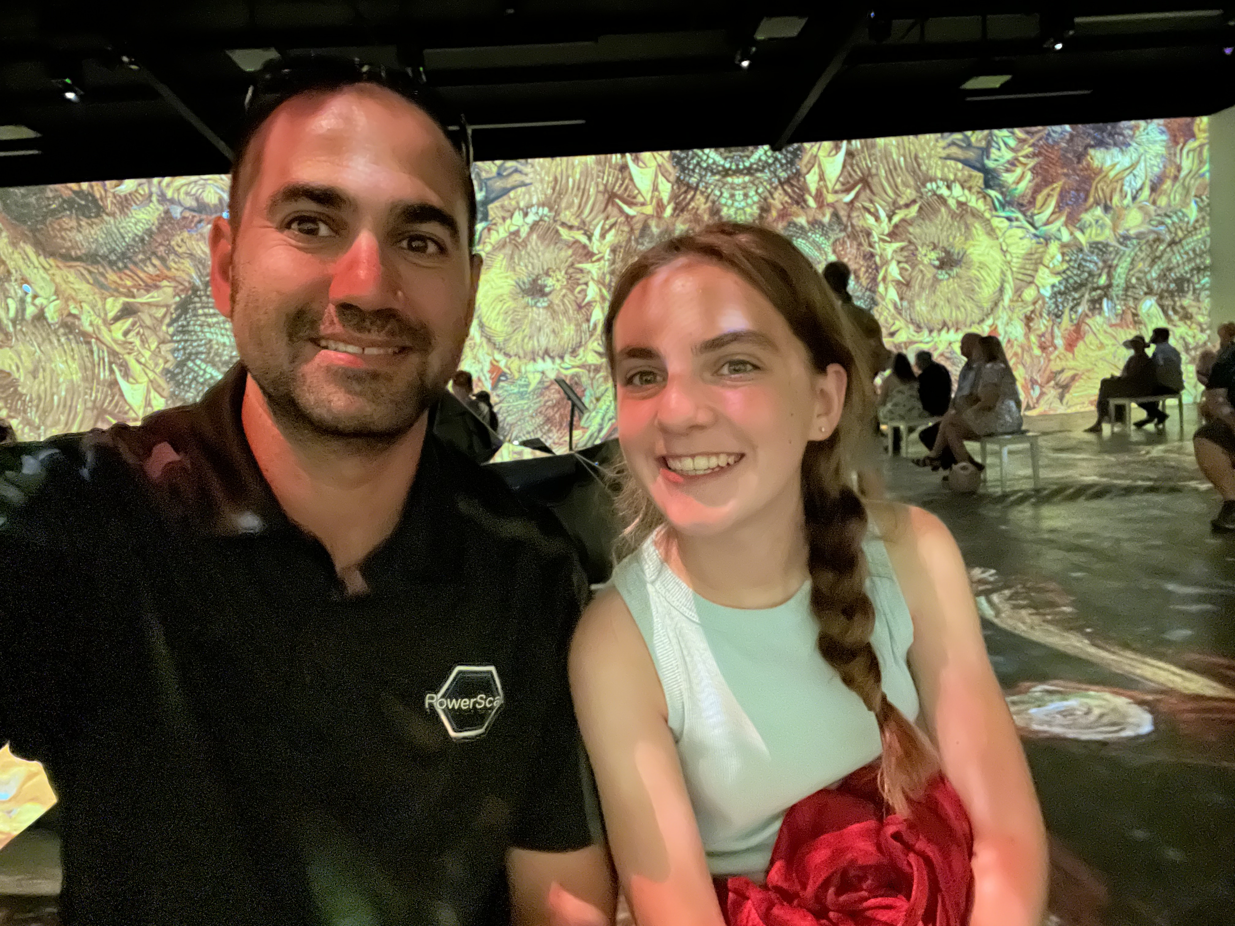
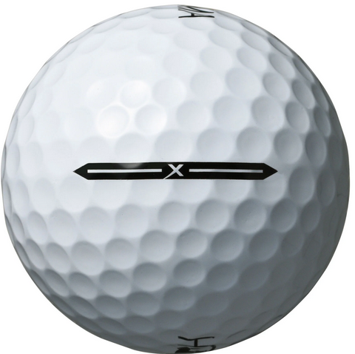
About me
Blog
Invoke-automation.blog
Twitter(X)/Slack/GitHub
jpsider
VMware Programs
VMUG Advantage
VMUG Board of Directors
vExpert x10
VMware {Code} Coach
PowerShell Developer

Slide 4
Invoke-VCF –Version 9 –InstallType Full –Confirm:$False
Tune in to this Virtual session to learn about how Belay Technologies took a programmatic approach to evaluating and planning how we will deploy VCF. During the session,
I give an overview of the current deployment architecture of our current infrastructure and review the differences as we deploy VCF in a greenfield environment.
The session will cover key decision points that will allow our team to take full advantage of the VCF software suite to ensure we get the best bang for the buck.

Slide 5
Agenda
About Belay’s Workloads
Current Deployment
Future Deployment (VCF)
VCF Considerations

Slide 6


Belay’s Workloads
Automated Range Testing
Provisioning Engine
Task Execution Engine
Think along the lines of VMware Hands on Labs
Other use cases
Security Patch testing
Integration testing
Range testing
SummitRTS.com

Slide 7
Challenges
Scalability
Identify and remove choke points
Efficiency
Use maximum compute at all times
Security
Separate customer workloads
Throughput
Get user results as fast as possible

Slide 8
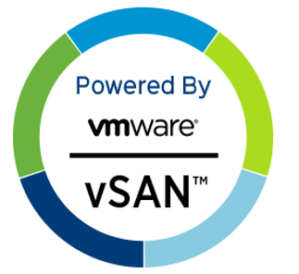
Current Deployment
VMware Products
vCenter
ESXi
NSX
LogInsight
Kubernetes
Rancher
Lots of PowerShell
Automation & Monitoring
Lots of Python
Automation & Monitoring
Single Namespace per Test Range (our software)
Each Test Range has its own NSX Domain
Assign a test range per customer
Or allow them to share based on SLA’s
No vSan
Storage is NFS & iSCSI

Slide 9




Current Architecture
Management Cluster
NSX Management Cluster
Test Range

Slide 10
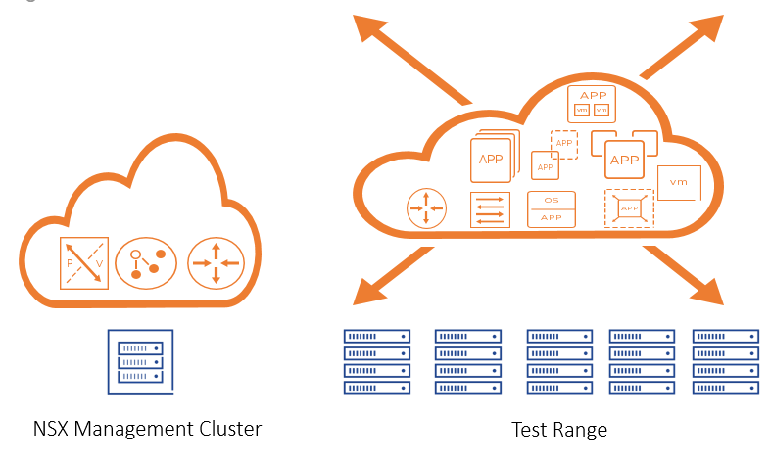
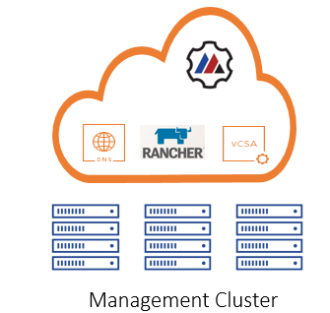
Current Architecture
tr6
tr1
tr5
tr2
tr4
tr3

Slide 11
Current Deployment Considerations
Physical Separation of Infrastructure and Test Range
Security Boundaries
Upgrades - Our software & 3rd party
Multiple NSX Domains
Infrastructure
Test Range
Multiple Test Ranges (VMware Limitations)
Prod, Pre-Prod, Integration
Hardware Refresh

Slide 12
VCF Deployment
VMware Products
vCenter
ESXi
NSX
LogInsight
VMware Aria Operations for logs
Aria Automation
Tanzu Kubernetes Grid
Single Namespace per Test Range (our software)
Each Test Range has its own NSX Domain
Assign a test range per customer
Or allow them to share based on SLA’s
No vSan
Storage is NFS & iSCSI

Slide 13


VCF Deployment(s)
Management Domain
Workload Domain
All the Management Things
All test range things

Slide 14
VCF Considerations
Physical/Virtual Requirements
Component | vCPUs | Memory
SDDC Manager | 4 | 16 GB
vCenter Server (Mgmt) | 4 | 19 GB
NSX-T Manager Cluster (Mgmt) | 24 | 72 GB
NSX-T Edge Node Cluster (Mgmt) | 8 | 16 GB
vCenter Server (VI WLD) | 8 | 28 GB
NSX-T Manager Cluster (VI WLD) | 48 | 144 GB
vRealize Suite (Total) | 116 | 332 GB
TKG Supervisor Cluster | 24 | 96gb
TKG Workload Cluster | 28 | 72 gb
Total | 264 | 795 GB
This does not include Workload domain resources!

Slide 15

VCF Considerations
VCF vs. VVF
NSX
Automation
Tanzu
Storage
vSan
External Storage
https://www.vmware.com/docs/feature-comparison-and-upgrade-paths-vcf-and-vvf

Slide 16
VCF Considerations
Aria Automation

Slide 17
VCF Considerations
Tanzu Kubernetes Grid

Slide 21





